Slide 1

Annual Parish Assembly
16th May 2022

Slide 2
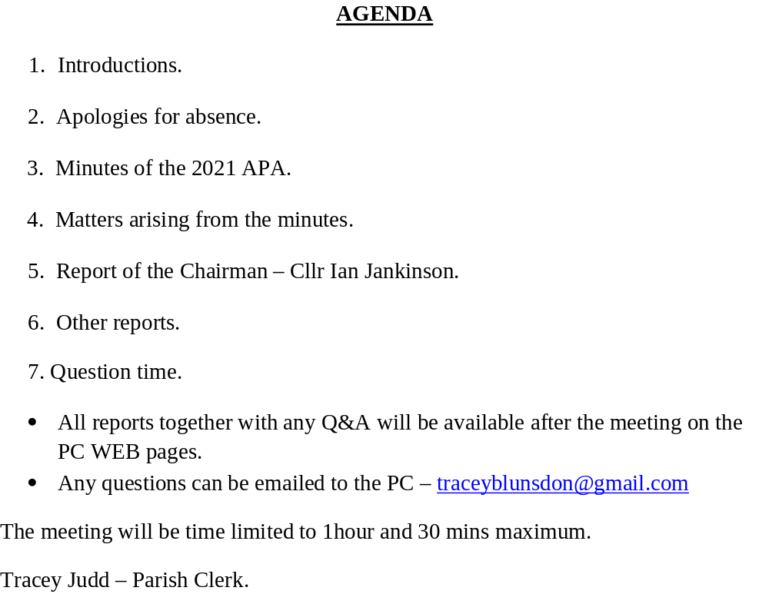
Annual Parish Assembly 2022

Slide 3
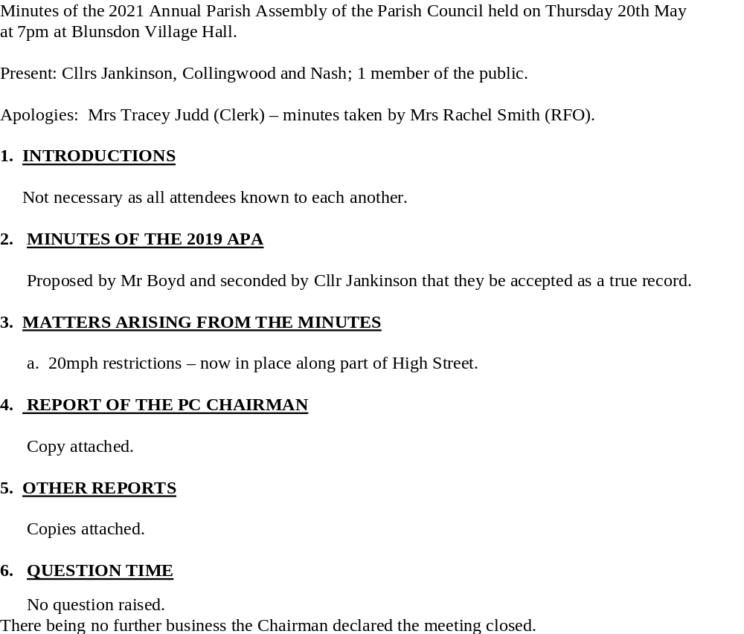
Minutes of 2021 A.P.A.

Slide 4
Chair’s Report
Thanks to all our staff and Volunteers
Coping with Covid 19
Best Kept Village
Stuart Boyd’s outstanding service to the PC
Finance and Budget planning
Working with St Leonard’s School, the Football Club and the Cricket Club to refurbish the Tennis Courts and Grassed Areas in Linley Road
Jubilee Plans for June
Working with St Leonard’s Church
Plans for Community Allotments
Plans for the new Community Building and Shop
New Play Area and Allotments in Broad Blunsdon Heights
62 Planning applications to consider and comment upon
Keeping costs the same as last year

Slide 5
Areas of Responsibility
Grounds Maintenance
  General grass-cutting, hedge-trimming, litter removal, dog bin emptying, fly-tip removal, graffiti removal
  Specific projects and emergency work – school path hedge, church path etc
  Maintaining a survey of all trees on Parish land
Recreation Areas
  Working with F.C. and C.C. and other users
  Maintaining hedge and trees
  Linley Road improvements
  Parking issues – hopefully these will be eased with the development of Linley Road and the transfer of the Community Building and car park
Blunsdon Village Hall
  Use levels have increased with the ease of the Pandemic
  Main Boiler replaced
  Complement the Staff and users who have minimised infection through thorough requirements
  Cemetery space is soon to be expanded with the grant of extra space from the landowners of the now Hayfield estate
Footpaths – as yet not our responsibility but that of SBC

Slide 6
Finance Officer’s Report
Over the latest financial year most of the local organisations have returned to hiring the Village Hall and recreational facilities regularly again so our income has increased.
The receipt of Community Infrastructure Levy payments (obligatory contributions from developers in the Parish) has also assisted with the costs of maintaining the village's amenities and public areas. Additionally, this has enabled the Precept to be kept at a similar level for our residents to the previous year.
The MUGA scheme is now well under way with planning expenses paid. This is the Parish's largest project to be undertaken for several years and once completed should be a great benefit.
The Parish Council's accounts are subjected to both an internal and external audit. The internal audit has been completed satisfactorily with no queries raised; the accounts will be submitted to the appointed external auditor shortly. Interested residents have the right to inspect the documents from 14th June to 23rd July by prior appointment.
Rachel Smith, Finance Officer.

Slide 9
Precept Breakdown
Precept per Band D Household Tax Base (households) Annual Precept
2022/23 £77.84 1,148.1 £89,370
2021/22 £77.52 1,094.6 £84,850
This represents an annual increase of 32p or 0.4% on last year. The average Parish increase across the 20 Swindon Parishes, was 3.4%

Slide 10
Other Reports
Speedwatch
  Many thanks to the small team who consistently patrol our Village roads, highlighting those who speed unnecessarily
  They also contribute significantly to Road Safety across the Parish. This being one of the Key Policies of the Blunsdon Neighbourhood Plan
Blunsdon Neighbourhood Plan
  Many thanks to Trevor Morton Holmes who was Chair of the Steering Group that enabled Blunsdon to strengthen the Planning Laws across the Parish
  These Policies are live and working in all Planning Applications as they are presented to the PC for comment

Slide 11

QUESTIONS?

