Slide 1

Annual Parish Assembly
20th April 2023

Slide 2
Annual Parish Assembly 2022
AGENDA
Introductions.
2. Apologies for absence.
3. Minutes of the 2022 APA.
4. Matters arising from the minutes.
5. Report of the Chairman – Cllr Ian Jankinson.
6. Other reports.
7. Finance Officer Report
8. Question time.
All reports together with any Q&A will be available after the meeting on the PC WEB pages.
Any questions can be emailed to the PC – traceyblunsdon@gmail.com
The meeting will be time limited to 1hour and 30 mins maximum.
Tracey Judd – Parish Clerk.

Slide 3
Minutes of 2021 A.P.A.

Slide 4
Chair’s Report
Thanks to all our staff and Volunteers
Tough year with rising costs
3.5% Reduction in Precept costs to residents
Fantastic Jubilee Weekend and Beacon Lighting
The sad loss of HRH Elizabeth II and the Accession of Charles III and Coronation celebrations planned for May
A much-needed extension to the Cemetery completed
A beautiful Community building housing a fantastic shop and café
A new children’s play area at Hayfield
New allotments and a children’s play area now in use at Minerva Heights
A new Church Path in collaboration with the Church
Plans approved for the refurbishment of the old tennis courts and grassed areas in Linley Road
Plans approved for a community allotment in a neglected area of the village

Slide 5
Plans for next year…
The refurbishment of the Pavilion and redevelopment of the Recreation Ground to make it more accessible, in collaboration with the Football and Cricket Clubs
Working closely with the Church to help with the reordering and development of the building into more of a community space
Planting 500 bulbs across the Parish to brighten up our Spring
Working with Swindon Borough Council Highways to improve the landscaping along Blunsdon Hill and Ermin Street to help better integrate the area into the Village
Planting more ‘Trees for Climate’ across the Parish
Put the Parish Grounds Maintenance contract out to tender to get us the most competitive price

Slide 6
Areas of Responsibility
Grounds Maintenance:
  The PC has defined areas of responsibility to maintain certain grassed and hedged areas, beyond these the Borough Council and National Highways have responsibility (although we monitor and report on any issues as they arise).
  The PC are aware of our environmental responsibilities and will consider a more balanced approach for some areas in terms of less grass mowing etc.to enhance habitats.
  The PC will continue to monitor our staff and contractors to help ensure we provide a tidy & green village and provide the best value within the financial budgets set. Additional projects will be considered to enhance the village further, where the budget allows.
  The PC employs a sub-contractor that completes a pre agreed schedule of works for the majority of the Parish’s requirements. During 2022/23 The PC has prepared and issued an invitation to tender document for the supply of grounds maintenance and litter collection etc., that is not completed by in house personnel..
  During 2023/24 The PC is planning to develop the area of derelict ground adjacent to High Street / Pontings Close into a community allotment, including reinstating a public bench within the area.

Slide 7
Struggles with the Borough
Government squeeze on spending
Massive cost of Social Care
Statutory services only
Parishes will have to take up the slack
Maintaining good standards
Ward Councillors Surgery
Over 50 Planning Applications considered and commented
Still 6 developments totalling 460 dwellings pending decision by SBC Planning
Kingsdown 1557 house development close to decision
Disputing the lack of support for infrastructure

Slide 8
Areas of Responsibility
Recreation Ground
  The PC has worked with the Football and Cricket Clubs during the year to manage their requirements, and any issues as they arise. The Parish has benefited from the active involvement of the BFC & BCC, in maintaining the pitches to their required standards.
  The PC has held meetings with the FC to consider the future for the pavilion which is beyond its original design life.
  It is noted that additional parking measures have been implemented by the clubs during the year in Sutton Park, and this has resulted in improvements for residents. The PC are anticipating this situation should be helped further by additional parking spaces available at the new community shop area, and at Linley Road (ref MUGA) when that scheme is completed.
  Additional tree management work has taken place at the edge of the recreation field during 2022/23
BVH & Cemetery
  The PC has continued to manage the village hall and are pleased to report use levels have increased back to pre-pandemic levels.
  The PC has continued to manage and maintain the village cemetery. There is an extension to the burial area now ready to be completed during 2023/24
Footpaths
  The PC does not have direct responsibility for footpath maintenance, this remains with the Borough Council. We do understand the importance of our many footpaths to residents and continue to monitor and report on issues as they arise.

Slide 9
Finance Officer’s Report
We have received several S106 payments (contributions from developers for specific Parish projects) to assist with the provision of a Multi Use Games Area, the completion of the Cemetery extension, and the new community allotment area.
Careful budgeting and the additional homes in the village has enabled the Council to set a Precept with a reduction for each household.
The Parish Council's accounts are subjected to both an internal and external audit. The internal audit is yet to be carried out but the accounts will be submitted to the appointed external auditor in early July and Interested residents have the right to inspect the documents in advance of this by prior appointment.
Rachel Smith,
Finance Officer

Slide 10
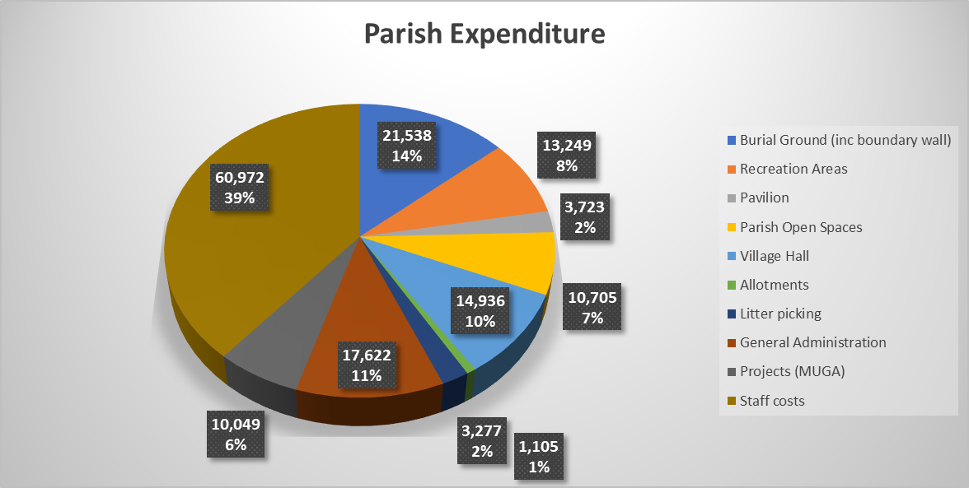

Slide 11
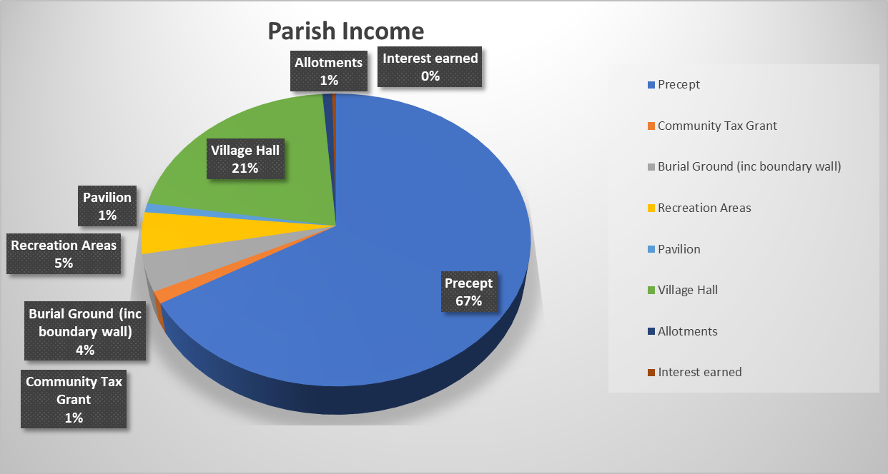

Slide 12
Precept Breakdown
Precept per Band D Household Tax Base (households) Annual Precept
2022/23 £77.84 1,148.1 £89,370
2021/22 £77.52 1,094.6 £84,850
2023/24 £75.03 1,310.1 £98,300
This represents an annual decrease of £2.49 or 3.5% on last year. The average Parish increase across the 20 Swindon Parishes, is 3.4%

Slide 13
Other Reports
Speedwatch
  Many thanks to the small team of volunteers who consistently patrol our Village roads, highlighting those who speed unnecessarily
  They also contribute significantly to Road Safety across the Parish. This being one of the Key Policies of the Blunsdon Neighbourhood Plan

Slide 14

QUESTIONS?

